Slide 1
IOT Greenhouse
Derrick Alders, Daniel Longo, Michael Wholey

Slide 2
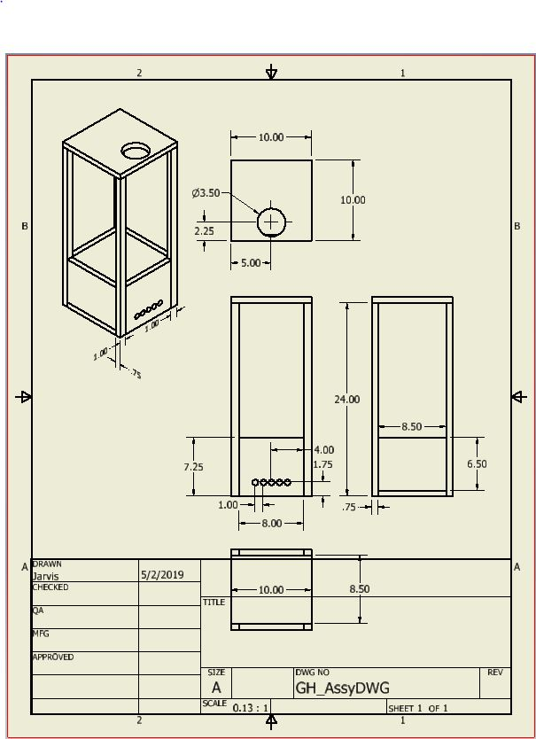
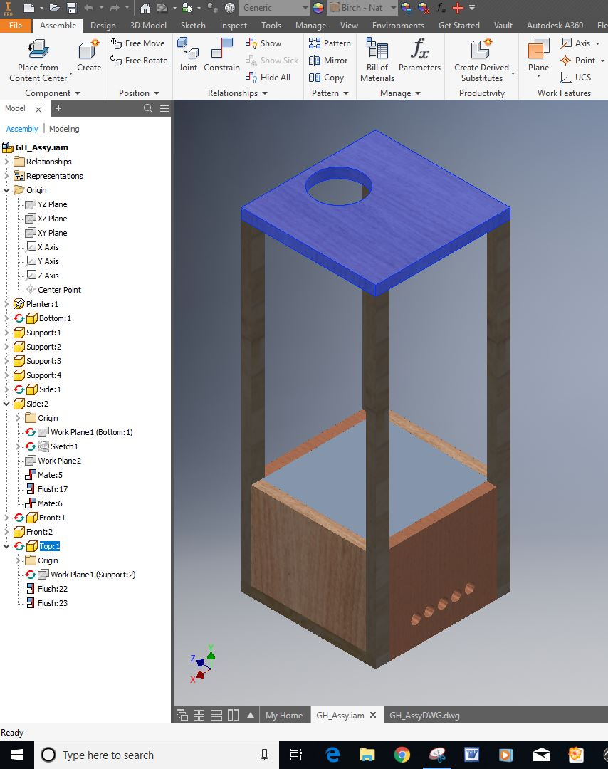
Concept and Design

Slide 3
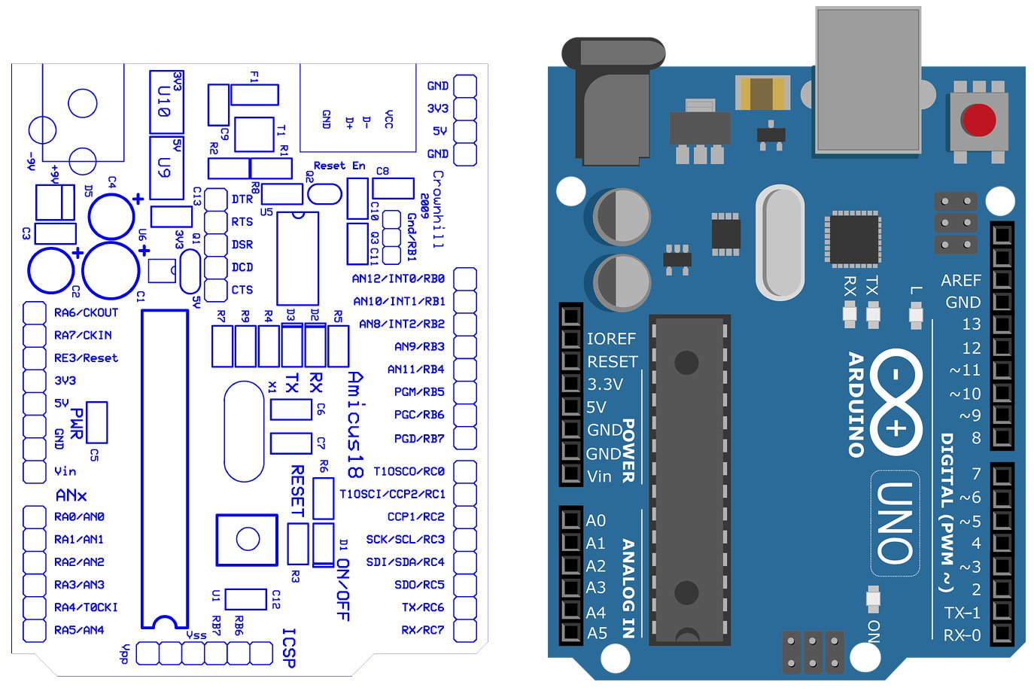
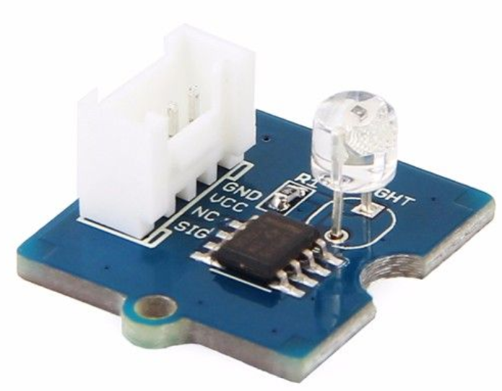
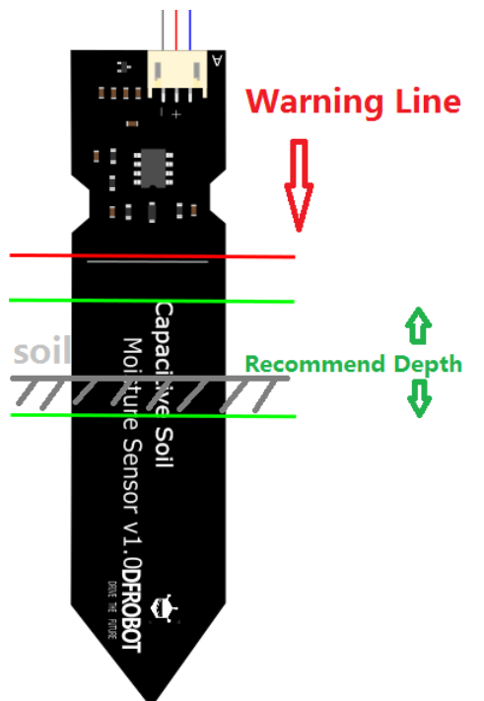
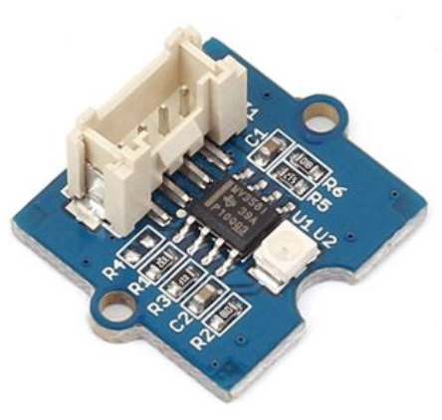
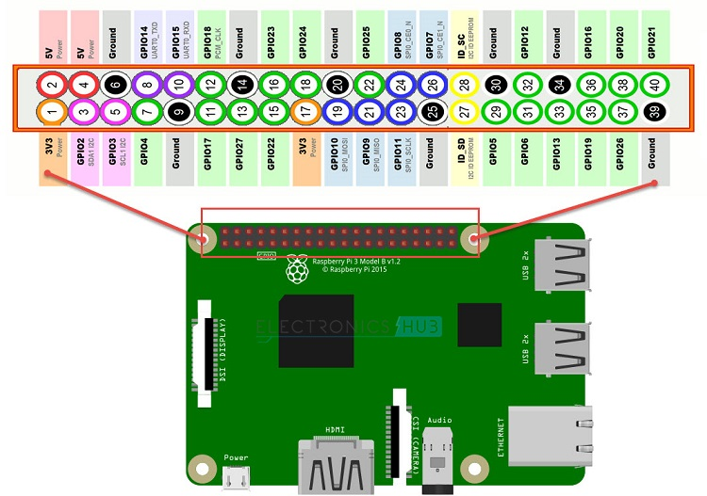
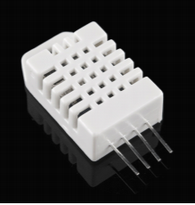
MCUs, Sensors, and Hardware
Arduino Uno: hosts the sensors
Raspberry Pi: runs the connectivity scripts
Temperature and Humidity Sensor
Soil Moisture Sensor
Light Sensor
UV Sensor
Light
Fan
Water Pump
LCD

Slide 4
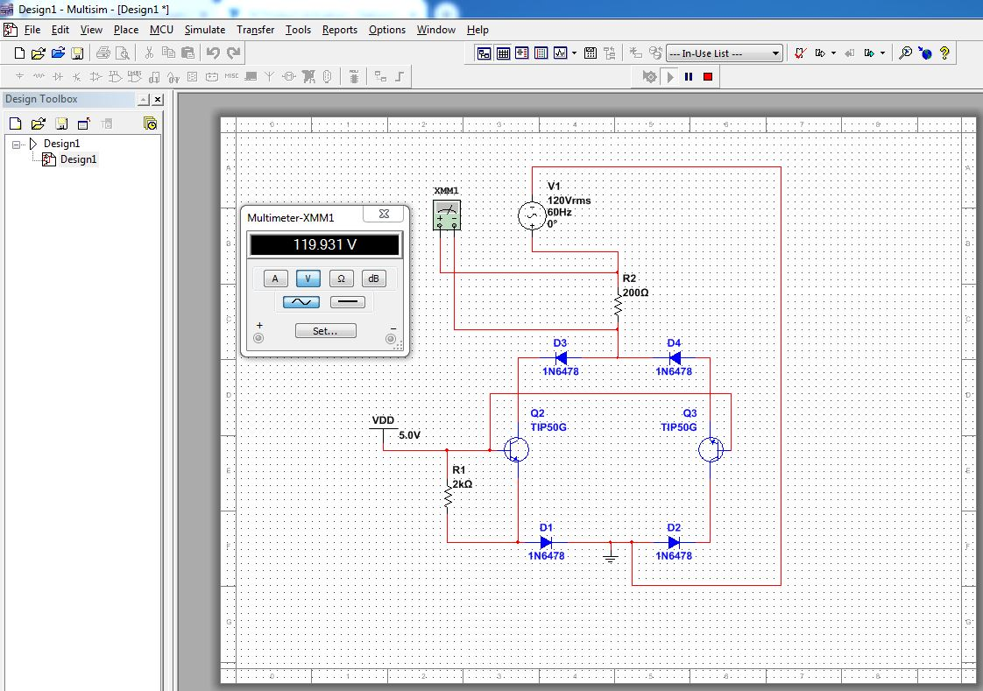
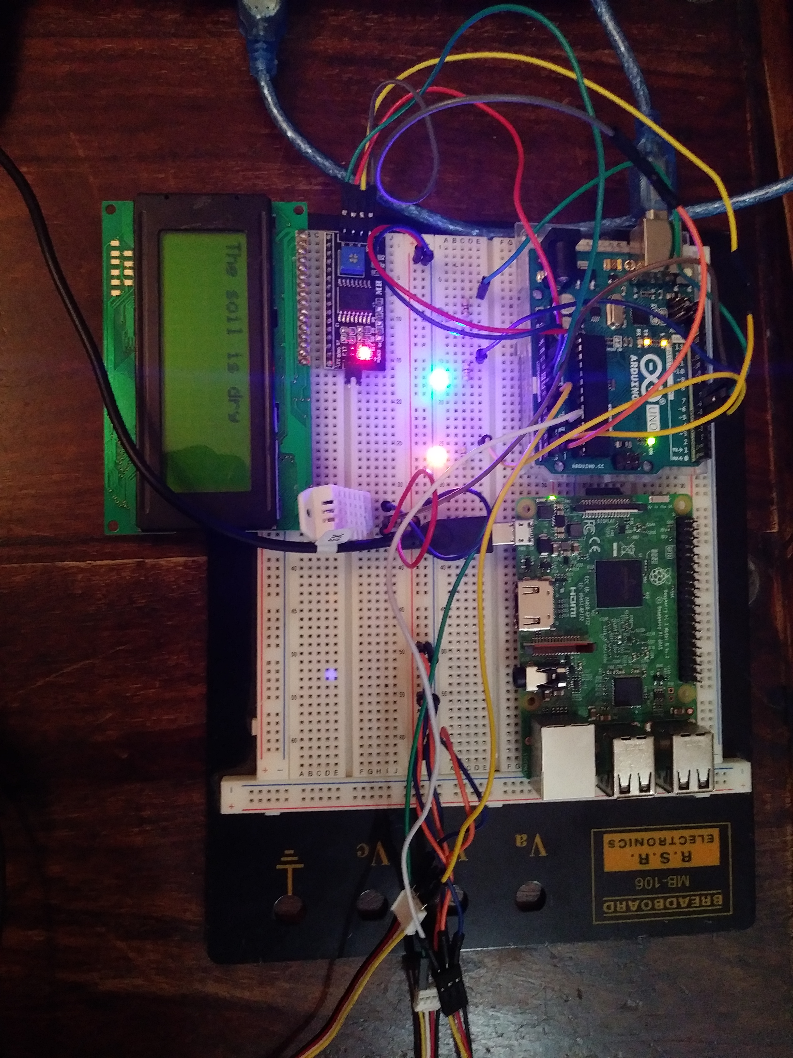
Circuit Layout
Mixed AC/DC
Serial COM between Arduino and Raspberry Pi
Wifi COM
Status LEDs
Improvements

Slide 5
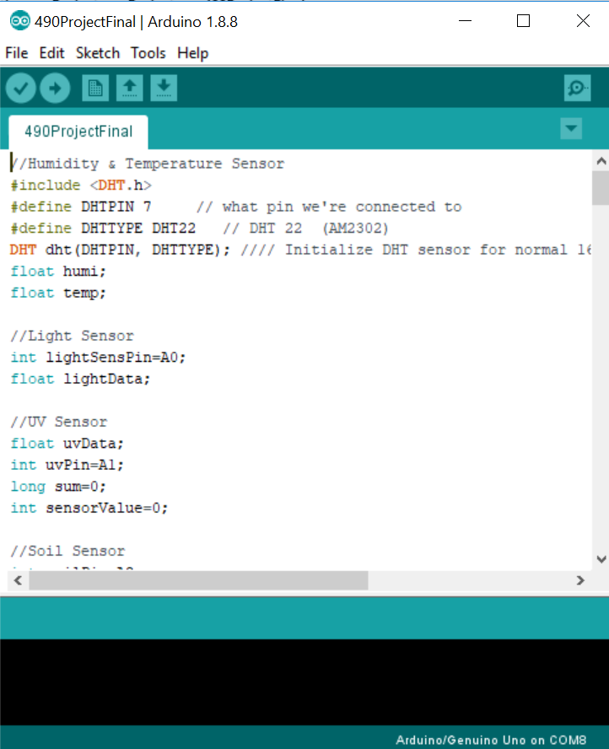
Arduino Code
//Humidity & Temperature Sensor
#include <DHT.h>
#define DHTPIN 7 // what pin we're connected to
#define DHTTYPE DHT22 // DHT 22 (AM2302)
DHT dht(DHTPIN, DHTTYPE); //// Initialize DHT sensor for normal 16mhz Arduino
float humi;
float temp;
//Light Sensor
int lightSensPin=A0;
float lightData;
//UV Sensor
float uvData;
int uvPin=A1;
long sum=0;
int sensorValue=0;
//Soil Sensor
int soilPin=A2;
int soilData=0;
const int AirValue = 520; //you need to replace this value with Value_1
const int WaterValue = 260; //you need to replace this value with Value_2
int dry = ((AirValue-WaterValue)*0.75)+WaterValue; // Value which is 3/4 of the way to dry from wet
int moist = ((AirValue-WaterValue)*0.25)+WaterValue; // Value which is 1/4 of the way to dry from wet
//Simple Write Pins
int lightPin = 4;
int waterPin = 5;
int fanPin = 6;
//LCD Declarations
#include <SoftwareSerial.h>
#include <LiquidCrystal_PCF8574.h>
#include <stdlib.h>
LiquidCrystal_PCF8574 lcd(0x27); // set the LCD address to 0x27 for a 16 chars and 2 line display
//Various other declarations
int fanTime = 0; //tracking if fan is not sufficient for temperature
bool lightState = true;
String dataAsCsv;
int messageIn;
int count = 0;
int letterCount = 0;
String message;
void setup() {
//Set inputs
Serial.begin(115200);
pinMode(lightSensPin,INPUT);
pinMode(uvPin,INPUT);
pinMode(soilPin,INPUT);
//Set LCD
lcd.setBacklight(255);
lcd.begin(16, 2);
lcd.setCursor(0,1);
lcd.print("SETUP");
//Set initial states
digitalWrite(lightPin,HIGH);
digitalWrite(waterPin,LOW);
digitalWrite(fanPin,LOW);
}
void lcdWrite(String message) {
lcd.clear();
lcd.setCursor(0,0);
lcd.print(message);
}
void loop() {
// DATA READ
humi = dht.readHumidity();
temp = dht.readTemperature();
lightData = analogRead(lightPin);
soilData = analogRead(soilPin);
// UV READ
sum = 0;
sensorValue = 0;
for(int i=0;i<1024;i++) {
sensorValue=analogRead(A1);
sum=sensorValue+sum;
delay(2);
}
sum = sum >> 10;
uvData = sum*4980.0/1023.0;
// PRINTING FOR TEST
// Serial.print("Humidity: ");
Serial.println(humi);
Serial.print("Temperature: ");
Serial.println(temp);
Serial.print("Light: ");
Serial.println(lightData);
Serial.print("Soil Humidity: ");
Serial.println(soilData);
Serial.print("UV: ");
Serial.println(uvData);
Serial.println("\n------------\n");
// Fan Heat Logic
if(temp>85) {
digitalWrite(fanPin,HIGH);
fanTime=fanTime+5; //5 is the second time of our whole loop. May need adjusting if we change delays.
if (fanTime>=300) {
digitalWrite(lightPin,LOW);
lightState=false;
Serial.println("LIGHT OFF FOR EXCESSIVE HEAT");
}
}
if((temp<80) && (lightState==false)) {
digitalWrite(lightPin,HIGH);
lightState=true;
Serial.println("LIGHT ON");
}
//Fan Moisture Logic
if (humi>60) {
digitalWrite(fanPin,HIGH);
Serial.println("FAN ON DUE TO EXCESSIVE HUMIDITY");
}
if (humi<60 && temp<80) {
digitalWrite(fanPin,LOW);
}
// Watering Logic
if(soilData > dry) {
digitalWrite(waterPin,HIGH);
Serial.println("WATER ON");
}
else {
digitalWrite(waterPin,LOW);
Serial.println("WATER OFF");
}
//Water LCD Logic
if (soilData > dry) {
lcd.clear();
lcd.setCursor(0,0);
lcd.print("The soil is dry");
}
else if (soilData > moist) {
lcd.clear();
lcd.setCursor(0,0);
lcd.print("The soil is lightly moist");
}
else {
lcd.clear();
lcd.setCursor(0,0);
lcd.print("The soil is wet");
}
//Here we Serial print our data, the raspberry pi will pick this up
dataAsCsv = String(humi) + "," + String(temp) + "," +
String(lightData) + "," + String(uvData) + "," +
String(soilData) + ",";
Serial.println(dataAsCsv);
delay(1000);
//We listen for Serial communication from the pi
//Possibly I will need a way to communicate success
for (int i=0; i<3; i=i+1) {
if(Serial.available()){
messageIn = Serial.read();
letterCount = letterCount + 1;
char y = messageIn;
message = message + y;
if (letterCount == 3) {
Serial.println(message);
if (message == "L1;") {
//digitalWrite(lightPin,HIGH);
Serial.println("LIGHT TURNED ON BY USER");
}
if (message == "L0;") {
//digitalWrite(lightPin,LOW);
Serial.println("LIGHT TURNED OFF BY USER");
}
if (message == "F1;") {
//digitalWrite(fanPin,HIGH);
Serial.println("FAN TURNED ON BY USER");
}
if (message == "F0;") {
//digitalWrite(fanPin,HIGH);
Serial.println("FAN TURNED OFF BY USER");
}
message = "";
letterCount = 0;
}
}
}
if(Serial.available()){
messageIn = Serial.read();
Serial.println(messageIn);
}
delay(1000);
}

Slide 6
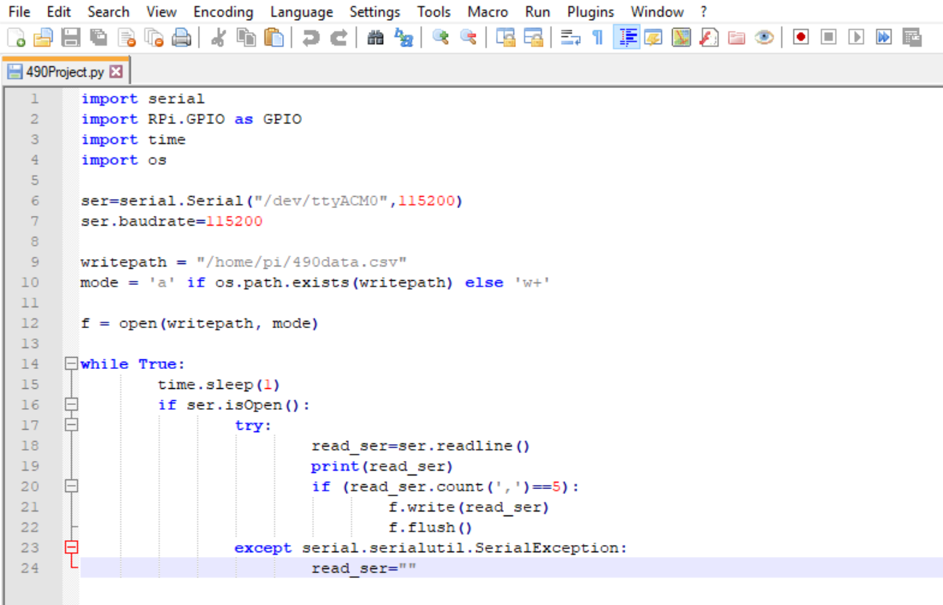
Python Code

Slide 7
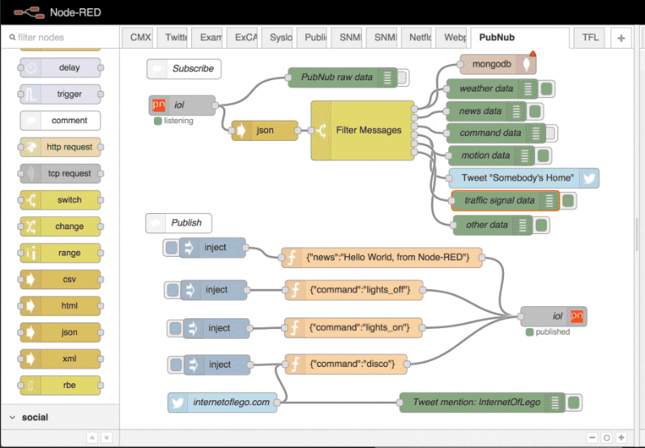
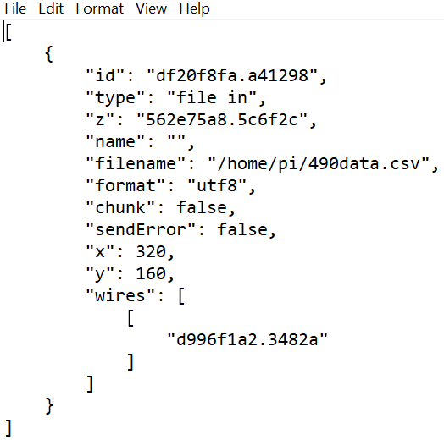
Node-Red

Slide 8
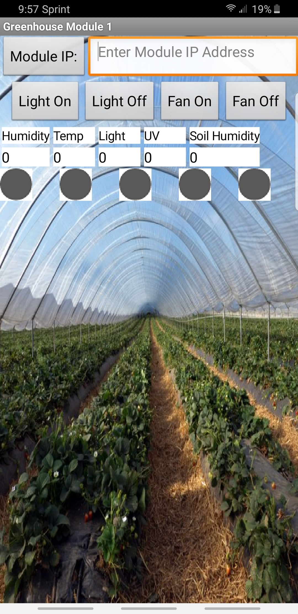
Mobile App
“Greenhouse Module Manager” (GMM) is a prototype name for our app. GMM allows the user to set an access IP Address, then send and receive data from the module at that address. It will also send you push notifications if the sensors detect an environment element outside your specified bounds.

Slide 9
How it Works
Upon startup, we see a blank box that asks for the IP Address of your module. Once entered into the text box, it will either connect, or give you an error if the module is unavailable on the network. Once connected, data begins to be received. As soon as data begins transmitting, the indicator lights (initially gray) will turn green. If any of the sensors end up detecting module environment elements change past certain thresholds, the indicator lights will become red, and a push notification will be sent to your phone. These values are updated every 5 seconds.
For example, if the user were to press the “Light On” button, and the signal sends successfully, but the light sensor doesn’t respond, a notification will appear and the indicator light will become red. Another example would be if the temperature in the module changes to either below 5° Celsius (~40° Fahrenheit) or above 35° Celsius (~95° Fahrenheit), the indicator light would turn red and a notification would be sent to your phone.
Finally, the last feature to cover would be the ability to turn a mounted fan on or off. The fan will allow for remote changes in temperature and humidity in the module you’re currently monitoring.

Slide 10
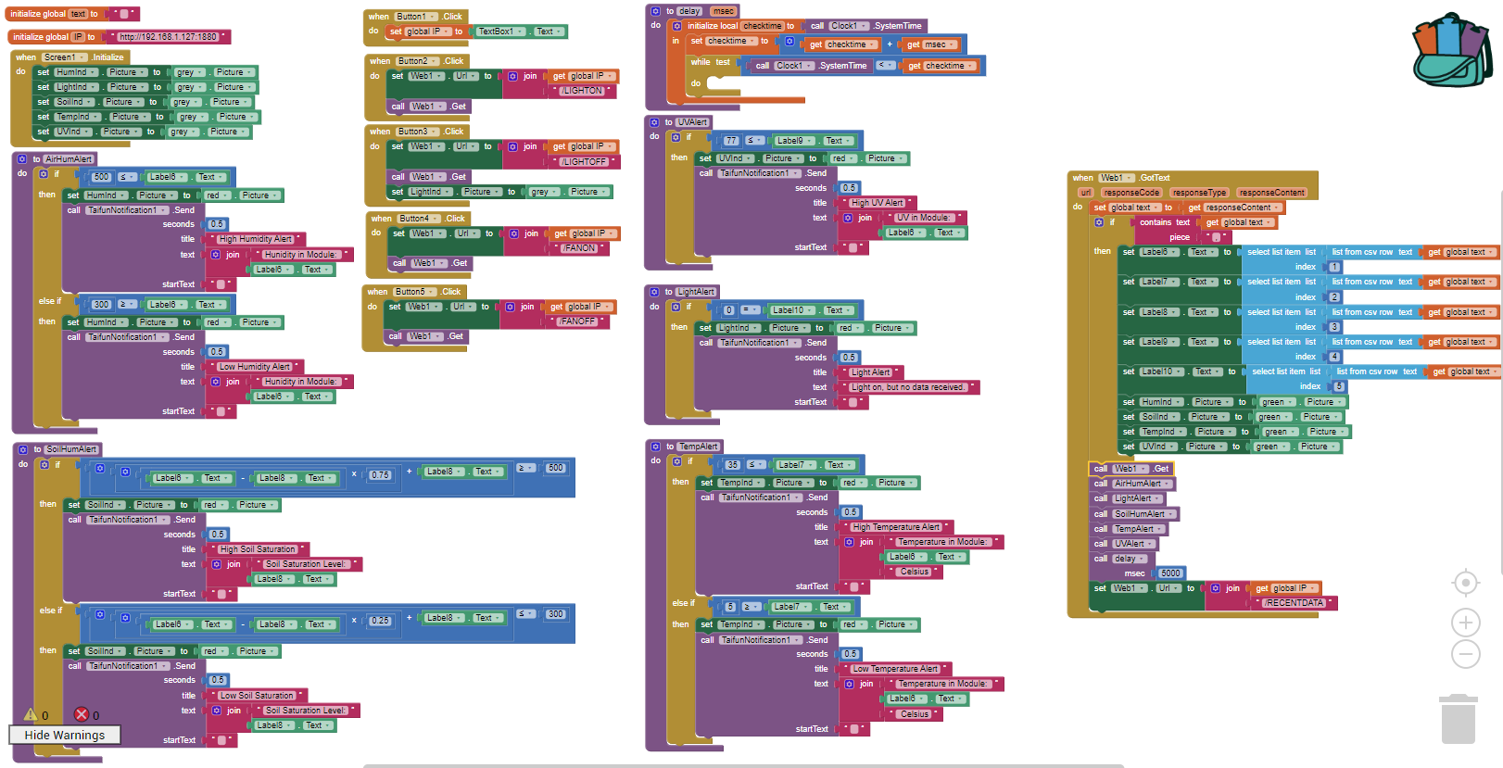

Slide 11
Possible Future Improvements
A graph showing the changes the module environment. This could be either at a time interval such as every hour, or when there’s an error message.
A slider that allows the user enter “Manual Mode” where the user could change the threshold values that the sensors must validate. Presently, the user must edit the thresholds in the code directly.
The ability to manage multiple modules from the same app. By adding multiple screens, and an interface to switch between them, we could manage several modules simultaneously.

